Slide 1
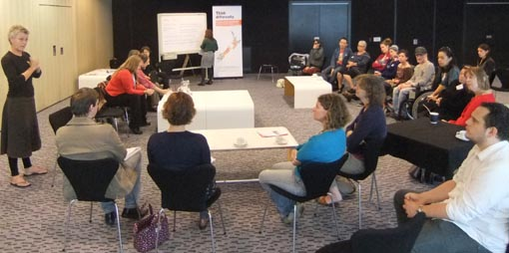
Developing an accessibility strategy

Slide 2
In this talk we will discuss
an accessibility strategy
an accessibility policy
getting started - steps to consultation and writing

Slide 3
What will our accessibility strategy look like? and does this lead to providing a policy?
An accessibility strategy is a plan for ‘how to get there’ that starts with an audit of where you are now
An accessibility policy is a written document demonstrating your organisation’s commitment to accessibility. It helps your organisation and people with access needs see that your commitment is long term and they are stakeholders in it
Added to your accessibility policy will be an action plan or strategy which lists how you will implement the policy via people, steps, intentions, tasks, time lines, measurements and reviews. A strategy can come first.
It should be endorsed by your board and senior management

Slide 4
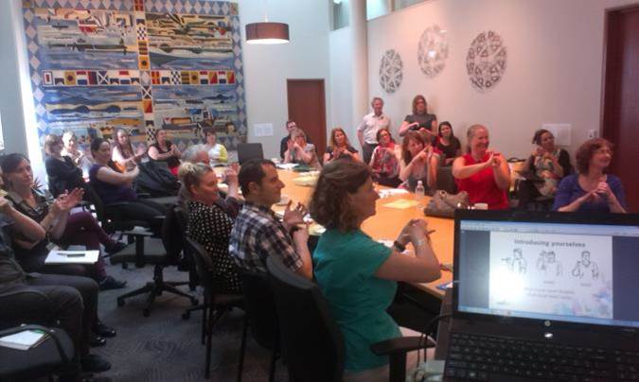
Consider these principles when seeking strategic planning and policy development
dignity
independence
integration and inclusion
equal opportunity
consultation
(internally and externally)

Slide 5
What are we doing well?
Where are we going?
How will we get there?

Slide 6
Where does the responsibility sit and who is involved.
A strategic plan and policy is required by the organisation in order to embed the rules, practice or procedures around accessibility and inclusion at a governance level.
All people in the organisation (including the Chief Executive, Director, senior management and the board) are involved in and own the policy and the activity it generates.
It should not only be the domain of one
person ‘who cares’ (because if this person
leaves the momentum and consistency is lost)

Slide 7
Your accessibility policy
A list or set of practices or procedures that guides your day to day activity in accessibility and inclusion. You should always be able to ‘fall back on the policy’ for guidance if needed
An accessibility policy adopted by your organisation will support your organisation’s overall mission or purpose. Your accessibility strategy and or policy will have a statement of intention (mission) that all aspects of the document aim to support
You may add accessibility clauses into existing policies and procedures

Slide 8
Design your policy in consultation with people with lived experience of disability and or their representative organisations for assistance
An accessibility policy for your organisation will reflect your unique activity, purpose and/or place. It will set out the steps for your organisation to become more accessible and inclusive of people who are:
~ disabled or impaired
~ have limited access
~ experience barriers to participation.

Slide 9
Considerations unique to your accessibility policy
Your accessibility policy would be adopted by your board and included in the organisation’s policy book or files. It would be available on your web site
It would be reviewed annually to make sure the policy is doing what it was intended to do
Your policy will reflect and support other aspects of your day to day running or activity in order to help that activity. (It should not be an unnecessary and unhelpful ‘extra’).

Slide 10
First steps
Your manager through to the CEO, or director of the organisation would want and understand that an accessibility strategy and or policy was needed
The CEO or director would propose to the Chair and/or trustees why an accessibility policy was needed or required
A timeline for policy consultation and writing would be set and a draft policy would be provided to the board by a set date

Slide 11
Next steps
Internal consultation: The process of getting an accessibility policy adopted by your organisation will include input and consultation with as many sections of your organisation as possible. Include ‘customer’ stakeholders and the Chief Executive, management, operational staff and the board where possible. This will avoid later resistance to complying with the policy. The ‘well I wasn’t told or involved’ syndrome….
The process of input and consultation may well uncover accessible practices that are already happening
The consultation process will obtain the knowledge of the people and stakeholders of your venue and visitor experience
External consultation: This process is when you ask people with disabilities and work with organisations that represent them what they require to make their access and inclusion successful.

Slide 12
Writing your policy: What it should contain
Title
Created date / updated date
Preamble/ Background/ Purpose/ Introduction: one or two paragraphs that explains (for anyone who would not normally know) why your organisation has this policy.
Definitions: You may want or need to define the terms used, such as the official name of the organisation followed by its working title if the two are different.

Slide 13
Writing your policy: What it should contain
Responsibilities: Brief paragraphs or bullet points that list what job title and or department is responsible for designing and implementing the policy. Include the assigned ‘job title role’ and department (not person) that has responsibility for action plans and further policy reviews.
When will the policy be reviewed? (Usually by the board, annually.)
Implementation: It is important to state the implementation of the policy via the strategic action steps of key departments and eventually the whole organisation
Resources and costs: If there are perceived costs and resources associated with the policy (e.g. staff time, web development, marketing, staff training ) consult on these items and also refer to budgets in action plans.

Slide 14
Writing your policy: What it should contain
Contact information: Office or unit with primary responsibility. List the ‘stakeholders’ (staff and other interested parties) who had input into the document so they are not forgotten in the next review.
Review: Put approved by (the board) date and then date of next review. Align this with the board’s annual policy review calendar so it is not missed and they can see actions have been taken.
Strategy and action steps): Series of steps (in bullet points if possible) that relate to your policy statement and explain what where and by whom. What steps/actions are being undertaken so that accessibility can happen?

Slide 15
Launch and review
Review your strategy and final policy with the stakeholders who informed it
You may hold a meeting or function to launch, acknowledge / promote that your organisation has an accessibility policy – and invite key stakeholders who are helping you maintain your best practice.

Slide 16
Developing an accessibility strategy and policy

