Slide 1
CNS Neurorehabilitation
Burwood Hospital

Slide 2
My Journey
Qualified as an Enrolled Nurse Birmingham England
ENB 153 Neurological and Neurosurgical Nursing
Moved to London and worked at Northwick Park Hospital when a new rehabilitation Unit opened in 1993
Transitioned to Registered Nurse
Post grad Diploma in Health Services Management
Moved to New Zealand November 2007 – Burwood Hospital
May 2008 Became CNS Brain Injury Rehab Service
Completed Post graduate Diploma In Rehabilitation
Feb 2018 CNS Neuro Rehabilitation

Slide 3
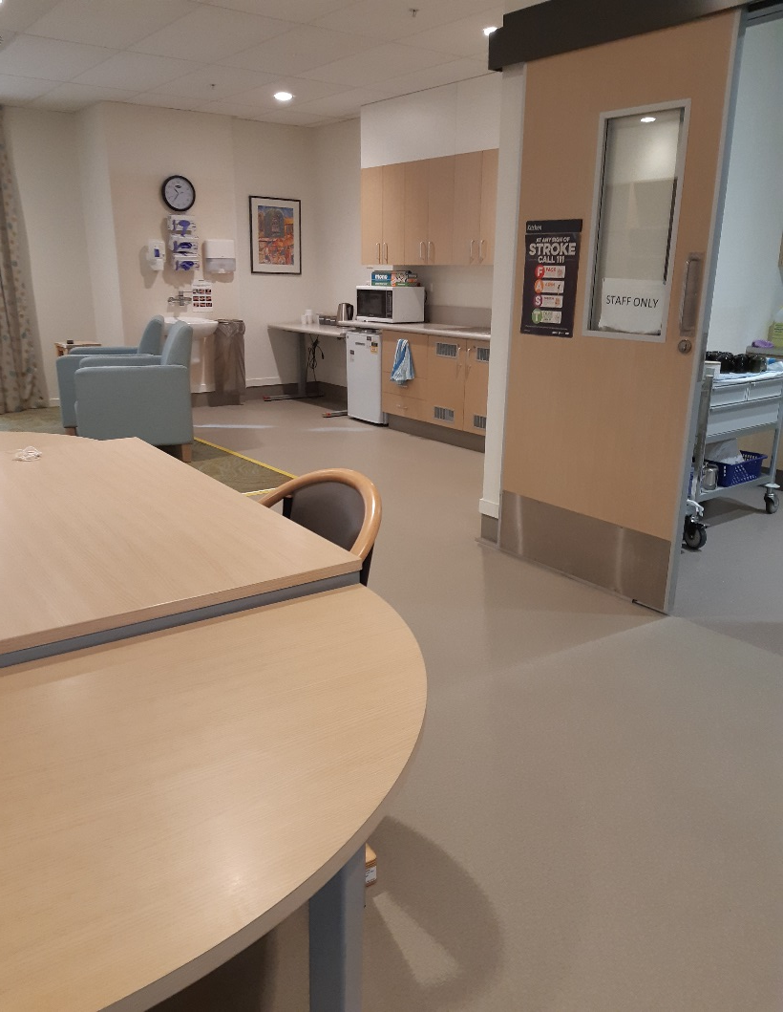
Ward CG

Slide 4
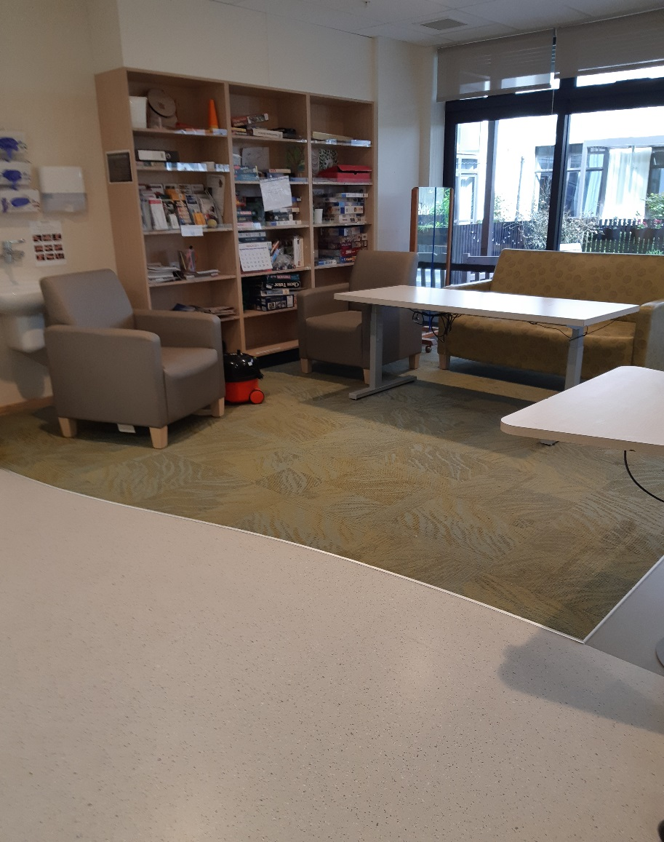

Slide 5
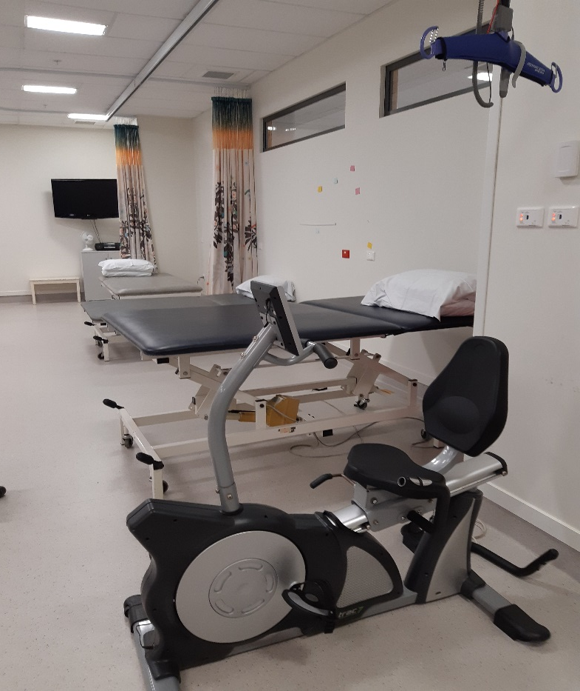

Slide 6
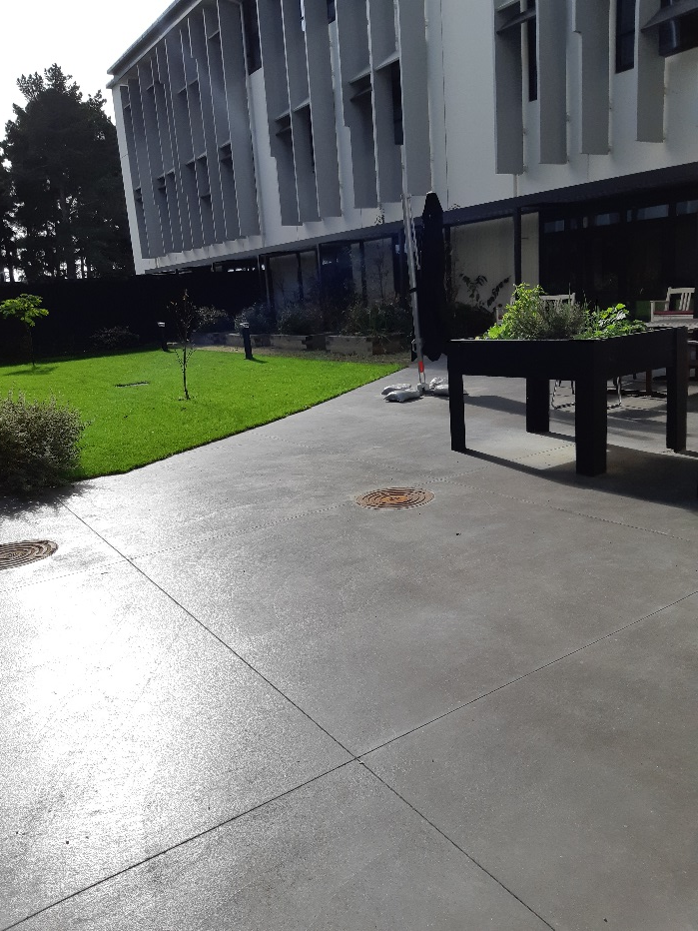

Slide 7
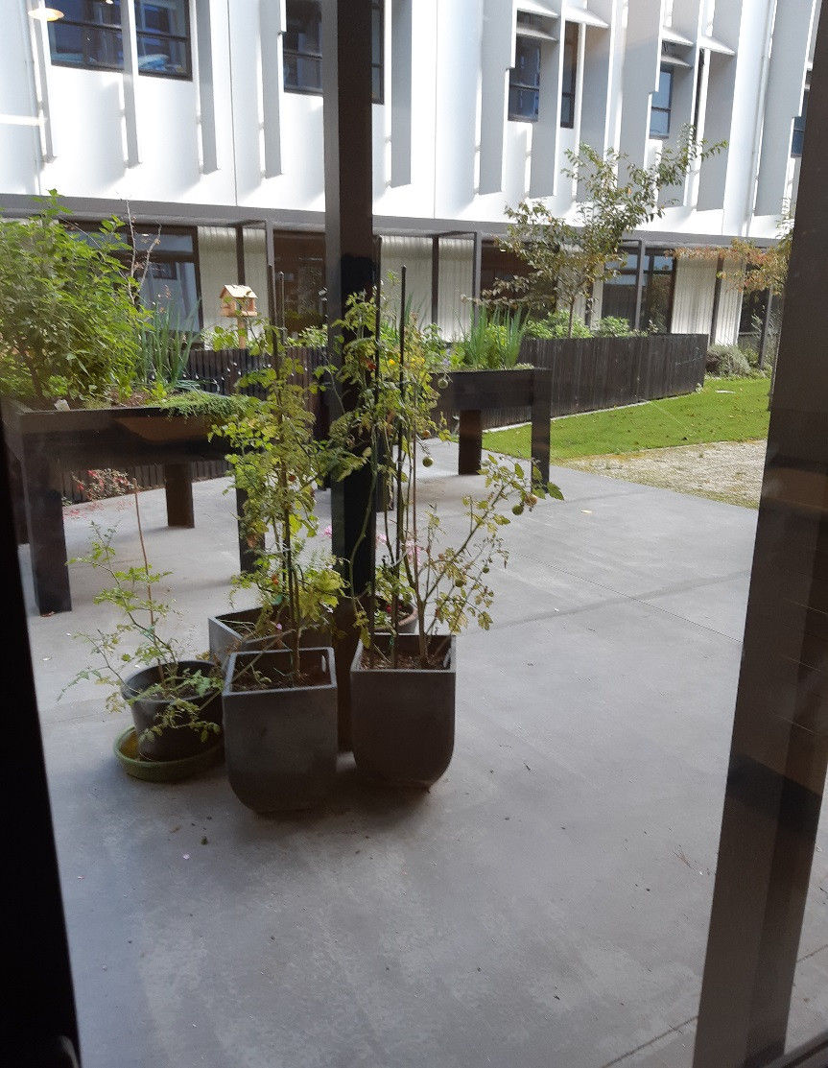

Slide 8
Ward CG
14 Beds – 13 Rehabilitation 1 Respite
Patients aged 16 – 65
70% Stroke
Subarachnoid Haemorrhage
Removal/Debulking Tumours
Encephalitis
Neurological conditions
Deconditioned
Traumatic Brain Injury
Spinal

Slide 9
Interdisciplinary Team
Nurses
Medical
Physiotherapists
Occupational therapists – outpatient VOC, Driving assessments
Speech and Language Therapist
Dietitian
Clinical Psychologist
Social Worker
Ranga Haoura
Music Therapist – Trial in 2018
Pharmacist

Slide 10
Length of Stay
Calculated by FIM score Use the AROC calculator for LOS

Slide 11
My Role
Start at 06.45 – Can liaise with night staff re any concerns
Assist morning staff to practice sitting balance with patients prior to hoisting, walking patients to breakfast club etc.
Medications – assisting nurses,
Attend board round
Working with individual patients / family – discussing concerns they may have with their health or rehabilitation.
Support for the team – reflecting on approaches suggesting alternatives.
Working with the nurses to support patients achieving goals, discharge planning.
Attending family meetings and IDT meeting

Slide 12
Bladder Bundle
Completing AROC Data forms
Organising education for nurses and the Interdisciplinary team.
Outreach home visits / phone calls
Providing education to Nursing students on the Role of the Rehabilitation Nurse.
Member of the CG Quality team

Slide 13
February 2018
CNS Neurorehabilitation
CG/DG and other Burwood Rehabilitation Wards

Slide 14
Case Study
40 year old female
Lives with partner and their 8 year old son in Christchurch
Mother sister and other family members live in Invercargill
Employed

Slide 15
Admission to CPH
27/08/18 Presented following 30 minute history of headache
left side weakness and inattention
complaining of neck pain
BP 188/88, Temp 36, RR 18, hr 62, 96%RA
CT scan on admission :
Right Basal ganglia haemorrhage with extensive intraventricular haemorrhage
Ventricular dilatation in keeping with hydrocephalus
No cause for haemorrhage evident on CTA

Slide 17
Past medical History
Migraines
Right Ovarian dermoid cyst removed 2011
Menorrhagia

Slide 18
ICU and Ward 28
Admitted to ICU
Started on vasopressors for hypotension then became hypertensive started on labetalol and hydralazine
Taken to surgery for urgent EVD placement on 27/08/18 – difficult placement, large bore EVD placed draining blood stained CSF.
EVD blocking due to blood clots – 3 further EVD’s inserted on 7/9/18, 9/9/18 and 1/10/18.
Started on Kepra for seizure prophylaxis
EVD removed
Progress fluctuated for a significant period – 2 months

Slide 19
October 2018
Mobilising with assistance
Speech improved now able to read sentences from magazines
UTI treated with ecoli
Ventriculitis – long term fluclox via PICC
Echo when investigating fevers – no endocarditis
?Bleeding disorder- Referred to haematology due to spontaneous basal ganglia bleed with ongoing bleeding from EVDs
Discharge to BIRS

Slide 20
BIRS (Ward CG)
Reviewed on Ward 28 by rehabilitation specialist.
Ready for rehabilitation 25/10/18
Doubly incontinent
Disorientated to age, month, time of day, day of the week, year
Memory issues
Supervision at meal times
Requiring hospital aid special

Slide 21
Sara steady transfer with 2 assist
No EPOA lacks capacity – Family issues
Poor insight and judgement
Assistance with ADLs
Fatigue
Impulsive
Recurrent falls
Family meeting held will refer for transitional rehabilitation

Slide 22
20/11/19
Transferred back to neurosurgery
Due to unsteady gait
Difficulty engaging in therapy
Ongoing incontinence
23/11/19 Required a left occipital VP shunt
27/11/19 Re admitted to BIRS for rehabilitation

Slide 23
Arrival back to BIRS
Could not remember the ward or staff
Orientated – appears clearer cognitively – Thought she had been in Australia
Improved gait and balance – Independent lie – sit, independent sit – stand, gait pattern smooth and symmetrical, constant speed.
Continent
Able to engage in formal testing in therapy sessions
Hospital aid special in situ as not ringing the bell
Requiring prompts to complete ADLs

Slide 24
Where do I want to be ???
Able to report family history accurately
Able to state she would prefer to stay in Christchurch but to ease the burden would go to Invercargill

Slide 25
4/12/19
HA special discontinued
Home visit
?some day leave at the weekend
Starting to initiate strategies
To check capacity

Slide 26
Goals
To walk independently to and from the toilet
To be able to get up off the flor independently
To initiate and complete personal care tasks independently
To ring the bell to ask for my medications
To keep a written log in notebook of activities each day so I can refer back to this when talking with friends and family
To plan and prepare a simple meal with supervision only
To initiate following my daily timetable
To have successful day leave at the weekend.

Slide 27
11/12/18
Aiming for discharge on 21/12/18
Refer to CREST and CSRS
Referred to Stroke Foundation
To have overnight leave prior to discharge
To have neuropsych testing in the community
Family do not want medication oversight they will support her to use a Dossett box which the partner will help her with.

Slide 28
21/12/18
Ready for discharge
Not able to drive for a year – she has been advised not to use any vehicles including scooters, quad bikes, biking etc
Not to return to work until next neurorehab review in 6 weeks then will require a gradual return to work programme

Slide 29
Return To Home
Home in time for Christmas
Partner had leave to support her over holiday period
Continuing to improve – however some difficulties with cognition
Concerns how to get son to school as unable to drive
Financial concerns
Could she ride a bike to take son to school?

