Slide 1
Māori drowning and injury insights

Slide 2
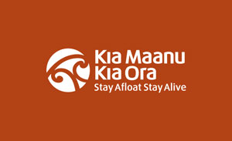
Data Sources
Drownbase fatalities (past ten years)
Drownbase hospitalisations (past ten years)
ACC claims
NZ Police SARs
Coastguard SAR will not be used as recording of ethnicity is very limited
RCC SAR will not be used as ethnicity is not recorded

Slide 3
Fatalities (preventable only)
Trending down over past ten years (per 100,000 of population)
A 35 years+ problem
Diving problem but high diving participation (ActiveNZ survey)
Regions of Northland, Bay of Plenty, Gisborne/Hawkes Bay, Manawatu/Whanganui hot spots

Slide 4
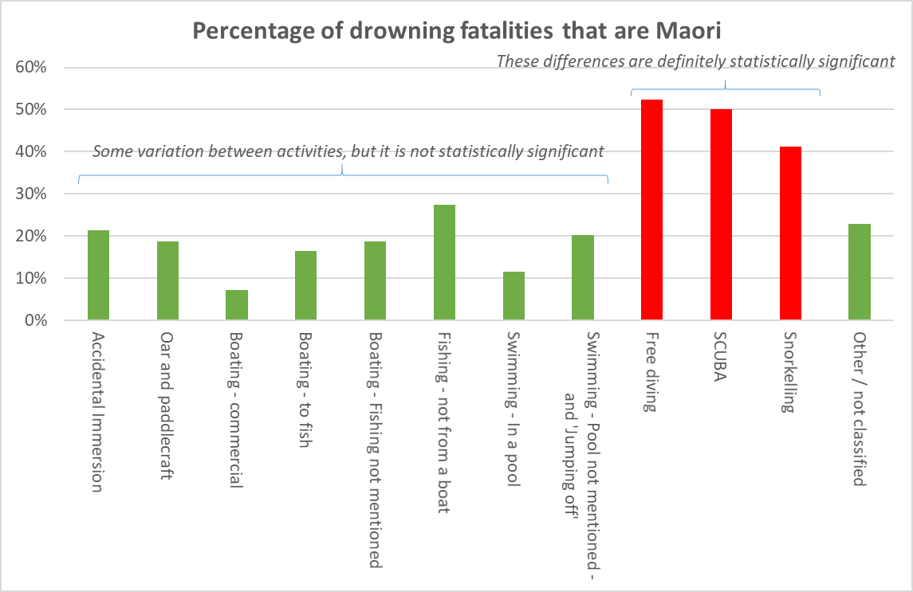
Māori are over represented among diving fatalities
There is a definite ‘hot spot’ around Māori diving fatalities
17% of Māori drowning fatalities involve diving of some sort
It appears to be driven by high participation in diving
Active NZ survey shows Māori participating in diving (of various types) at more than twice the rate of the general population
Kai moana?
Ace Journeys
Notes:
Causal factors that led to the deaths.
The two most common are:
Alone in the water (no dive buddy)
Bad water conditions (choppy, poor visibility, strong current etc).
The second tier includes:
Inexperienced / lack of training
Had taken drugs
Gear in bad condition
Gear poorly configured (too much / too little weight, too little air…)
No dive knife.

Slide 5
Hospitalisations (stay in Hospital for at least 24 hours)
Plateaued over the past ten years (per 100,000 of population)
Accidental immersions and swimming major factors
50% under 15 years
Under Fives over-represented

Slide 6
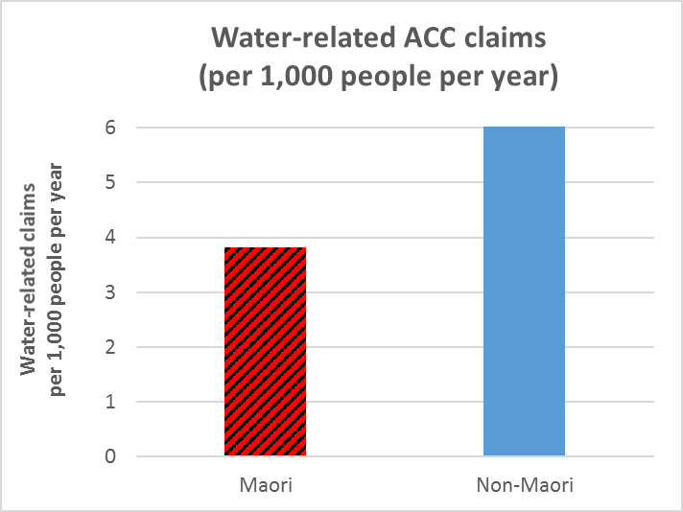
ACC Claims
We do not know whether Māori get injured more or less often than others
But Māori are less likely to seek medical treatment and file an ACC claim
For socio-economic and perhaps cultural reasons
Note that water-related injuries are far more common than drowning fatalities or hospitalisations
This chart shows claims per 1,000 people per year – earlier charts showed fatalities per 100,000 people per year!
Notes:
We have considered three levels of claims:
Described as being drowning (these are a small minority)
Really not clear whether the person was drowning or not
Definitely not drowning, nor even a near miss. This can be stuff like skin irritation from seawater, stung by a wasp, stubbed toe at the pool, cut on broken glass.

Slide 7
ACC claims
Under claiming vs non-Māori
Especially among over 35 year olds
Over represented in Accidental immersions, jumping and diving injuries
Majority of claims – jumping in, swimming and surfing

Slide 8
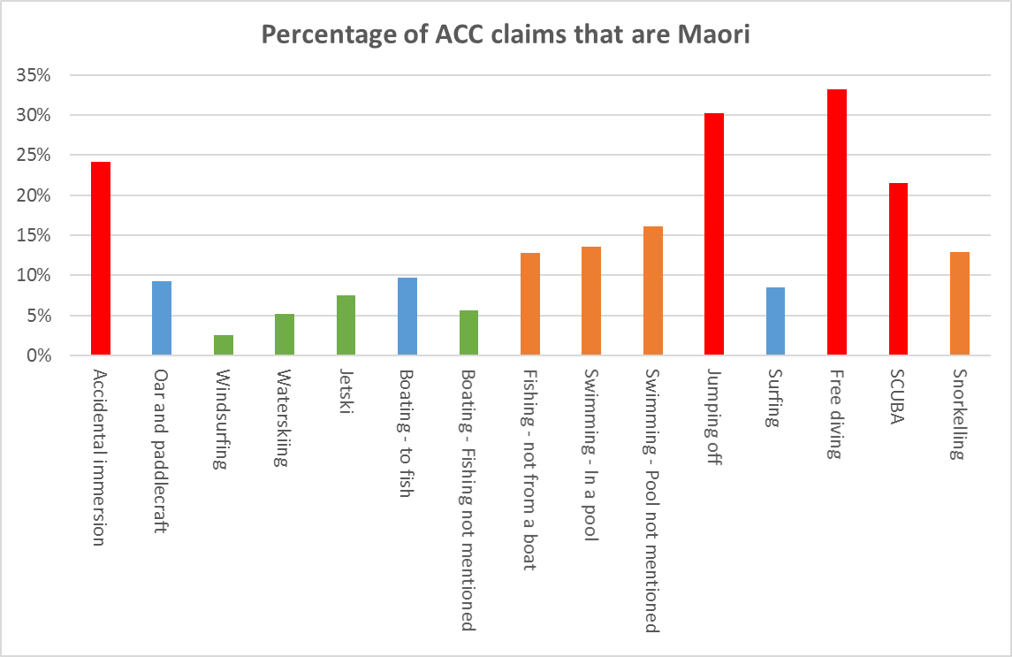
Over represented in jumping and diving injuries
Māori are over represented among ‘jumping off’ and diving claims
Driven, at least in large part by participation
Māori are also over represented among accidental immersion claims
Driven in large part by the under-5 age bracket
But accidental immersion makes up less than 1% of all water-related claims

Slide 9
NZ Police SAR (water)
Less likely than non-Maori to be subject of SAR
40% 15 – 34 year olds, 50% over 35 years
Jumping and diving SAR
Majority from boating and oar/paddlecraft
Major outcome - lightly injured or uninjured

Slide 10
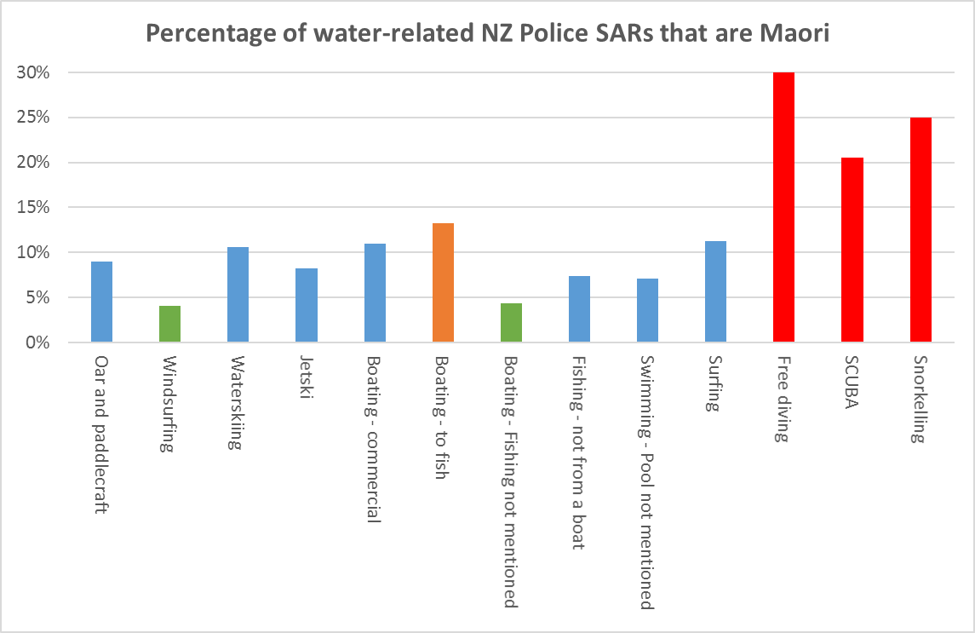
Over represented in jumping and diving SARs
Māori are over represented among jumping and diving SARs
Māori are under represented among ‘Boating – fishing not mentioned’ SARs
This is the single most common activity in the NZ Police data
Which explains why Māori are under represented among NZ Police SARs overall
Both differences are driven, at least in large part, by participation
e.g. Active NZ survey shows that Māori are less likely to participate in sailing / yachting

Slide 11
Māori drowning and injury insights

